Slide 1
Assessing and correcting somatic copy number fits
04/28/2022
Christoph Kreitzer
Niki Schultz lab

Slide 2
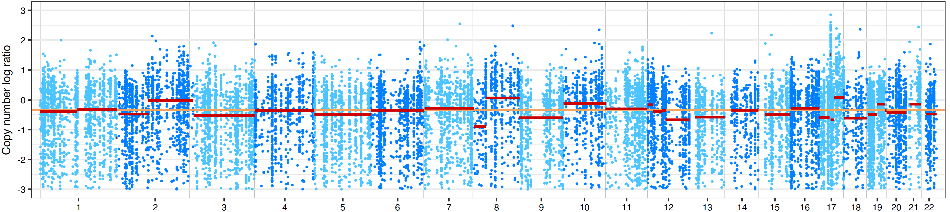
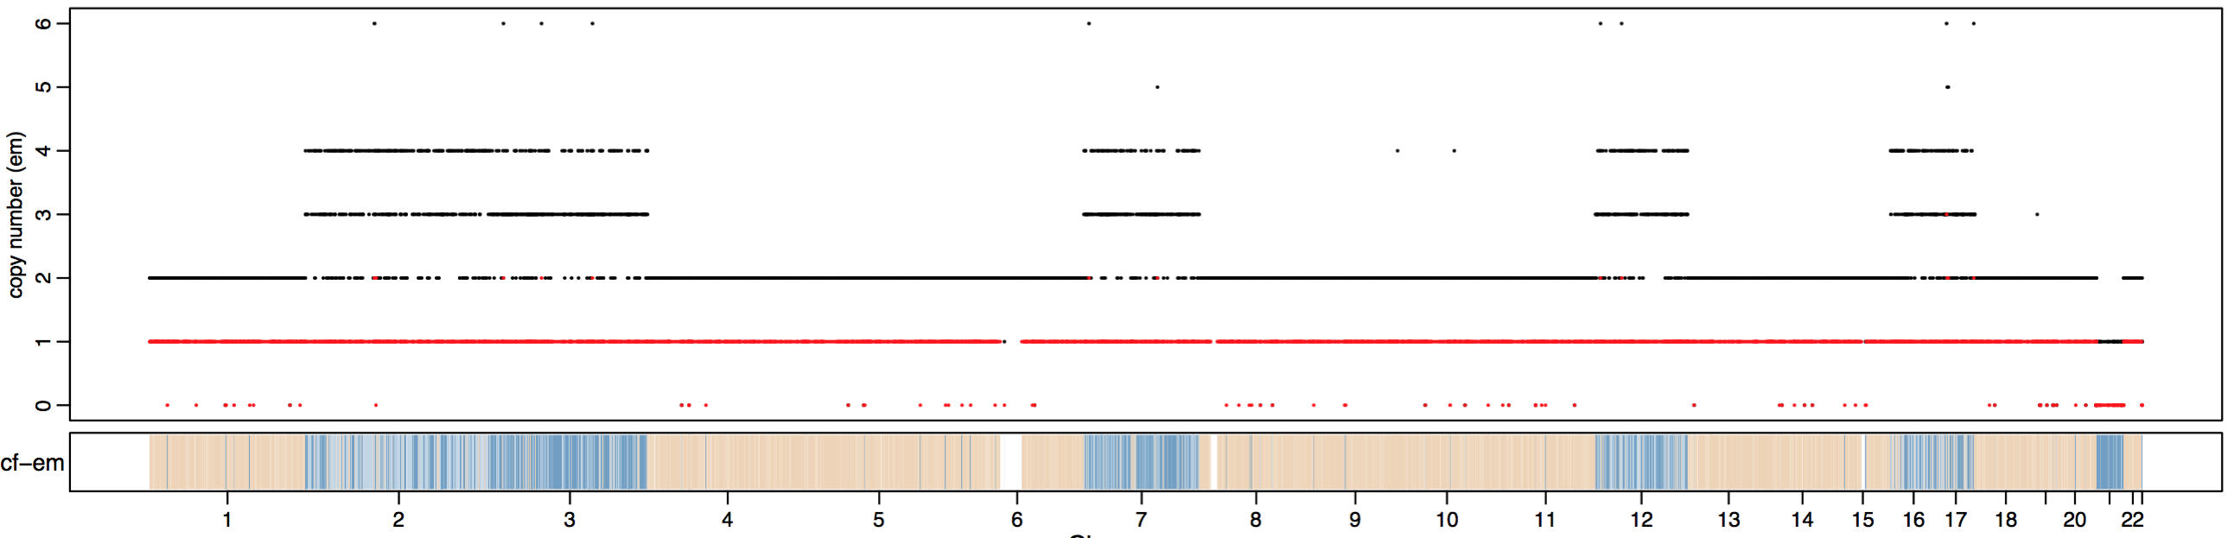
The problems we daily face…
We excluded 1,497 samples due to failed Facets-QC measures […]
‘waterfall pattern’
cval and dipLogR selection?
hyper-segmentation
Sample X has ploidy 7.84?
Should we believe in this fit?
cBIO and Facets calls do not match?

Slide 3
Outline
Copy number calling and counfounding effects
Detecting and eliminating ‘noise’
Implementation with Facets
What we can learn from the copy number fits

Slide 4
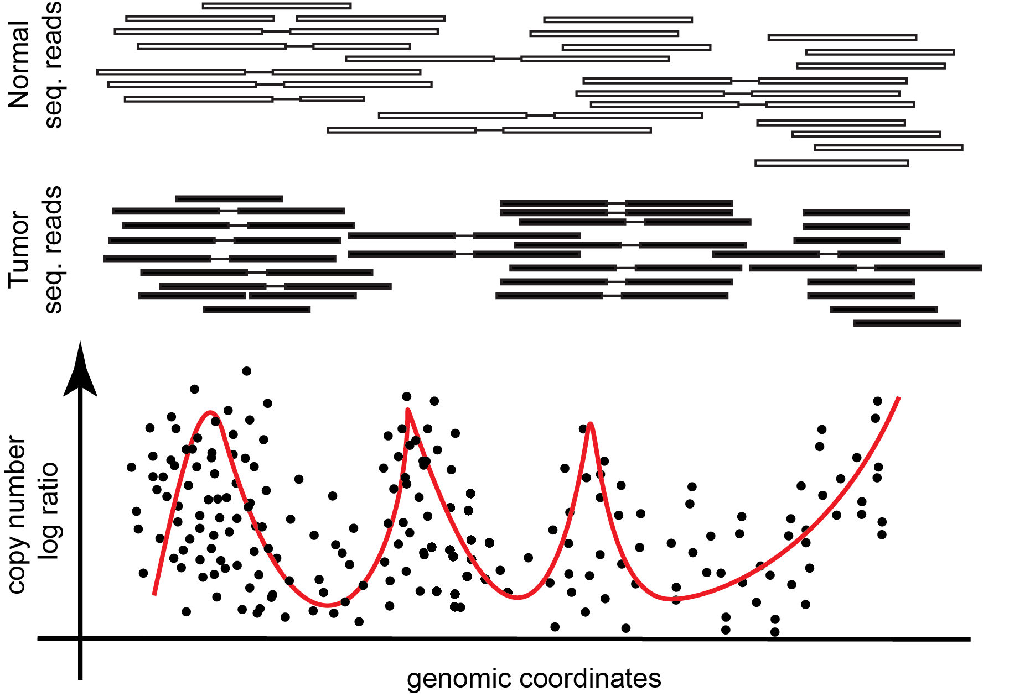
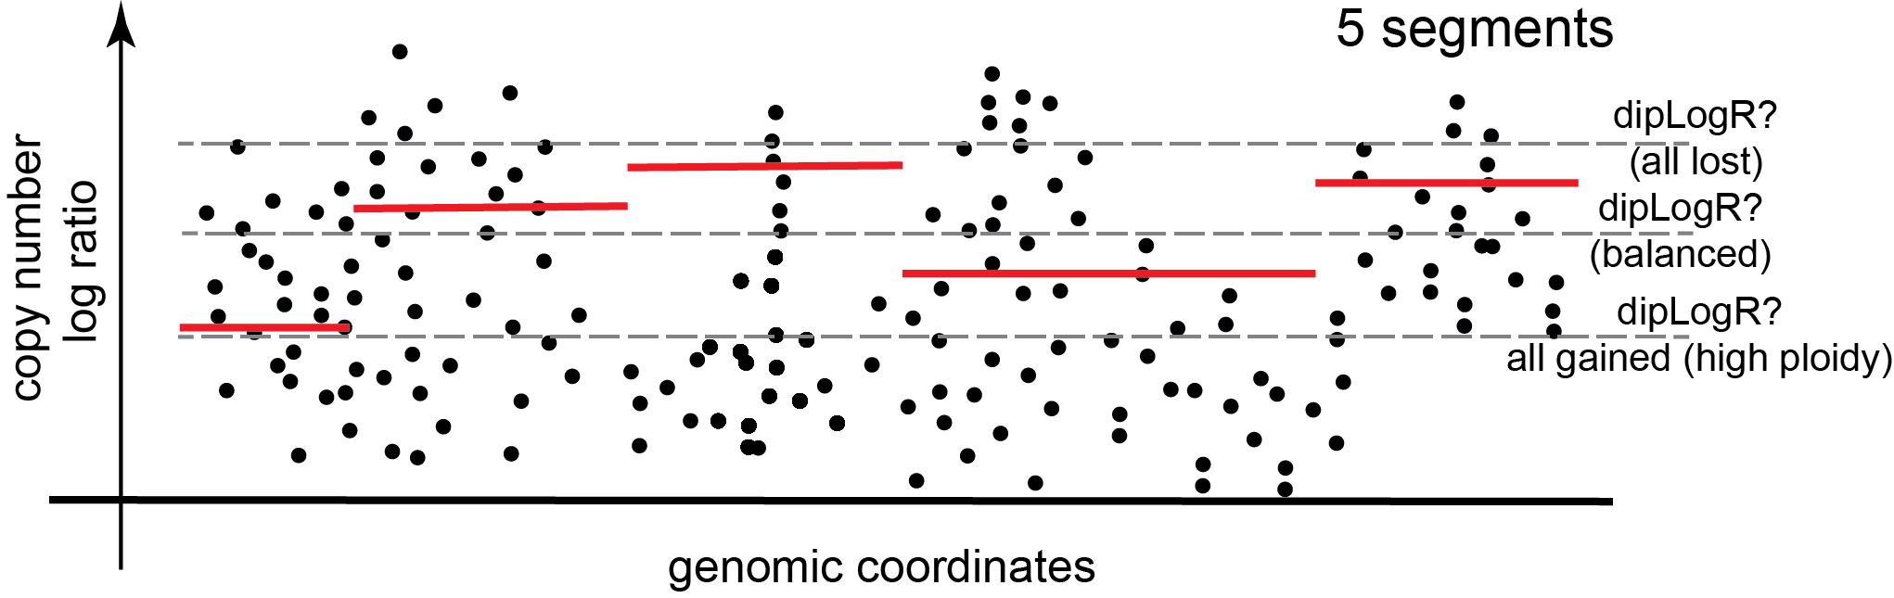
Copy number profiles in a nutshell
Introduction I: Cartoons loosly depict Facets’ framework
(if matched) sequencing of normal (blood)
Sequencing of tumor tissue
B-allele-frequencies (BAF) or logOR (Facets)
are used to determine allelic states; not shown here
Calculate log2(T/N) = copy number log ratio
(CnLR); correct for GC-bias (Facets)
Segmentation of CnLR profile (eg CBS).
Dependent on ‘cval’ (critical value)
Determine the dipLogR (CnLR at diploid gt.)
(segments below dipLogR == loss;
segments above dipLogR == gain)

Slide 5
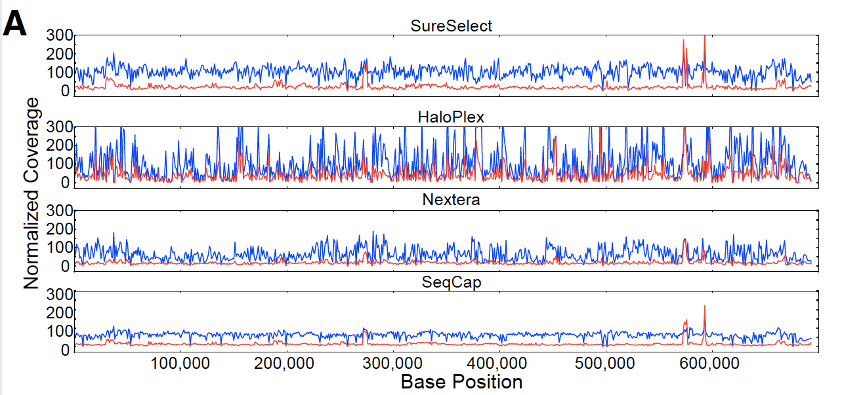
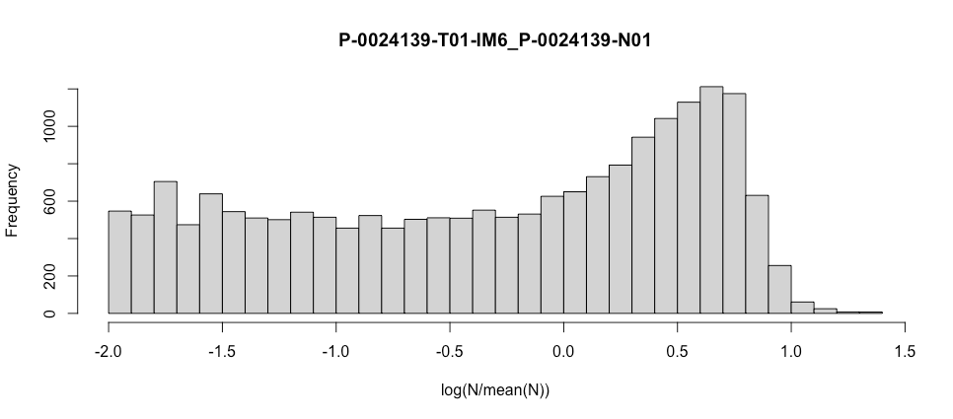
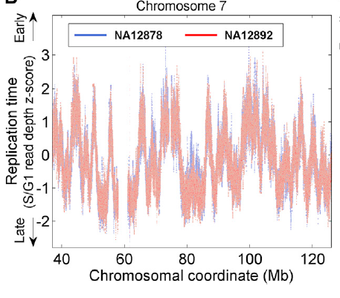
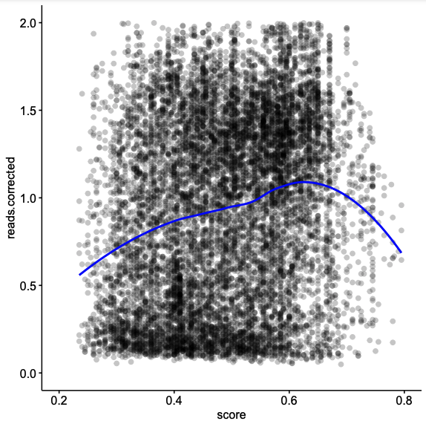
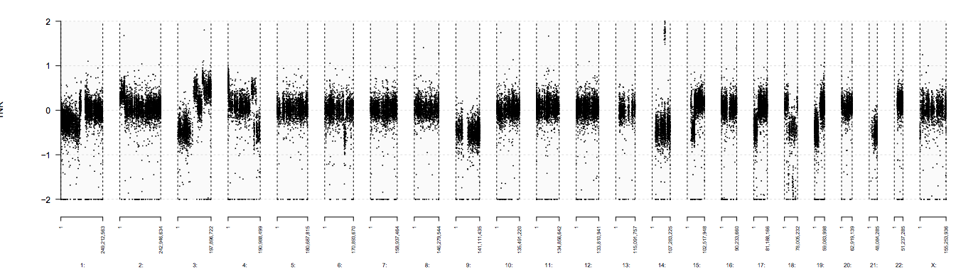
CNA inference: Multiple factors affect CNA calling
Introduction II: Facets correct for GC-bias; the remaining ‘problems’ persist
Variability in capture techniques
‘Bad’ (nonuniform) normal
Replication timing
Samorodnitsky et. al. JMD (2015)
Koren et. al. Cell (2014)
Mean normalized count
CNA profile
GC content

Slide 6
Ideal CNA normalization tool
Introduction III: The ‘background’ could give insights into other aspects of biology (eg. replication timing)
Eliminate assay and batch specific biases (termed “background”)
Retain loss and gain signals in read depth data associated with CNA (termed “foreground”)

Slide 7
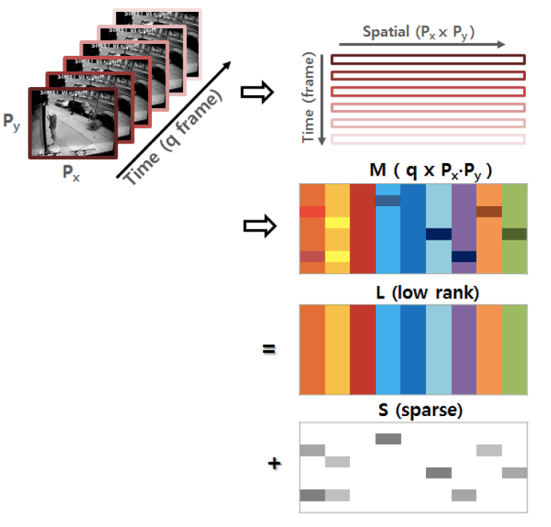
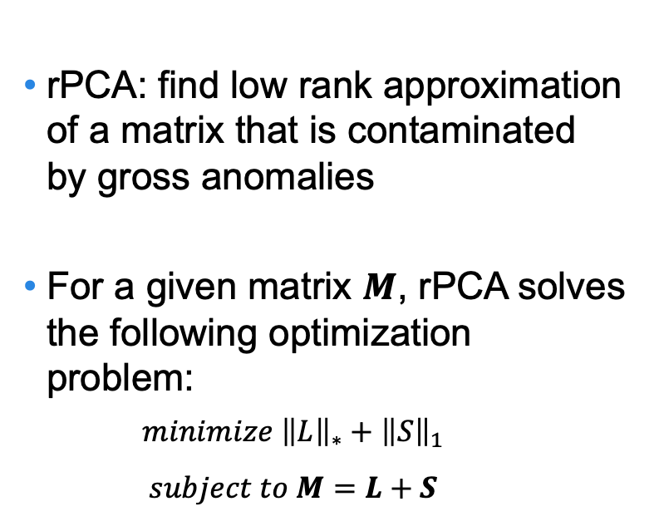
Robust Principal Component Analysis (rPCA)
Methods I: rPCA is used in separating foreground from background in vido surveillance, face recognition, etc.
rPCA: find low rank approximation of a matrix that is contaminated by gross anomalies
For a given matrix $M$, rPCA solves the following optimization problem:
$$minimize {\left\|L\right\|}_{∗}+{\left\|S\right\|}_{1}$$
$$subject to M=L+S$$
Chang, et al. The Proceedings of the IEEE Conference on Decision and Control. (2013)

Slide 8
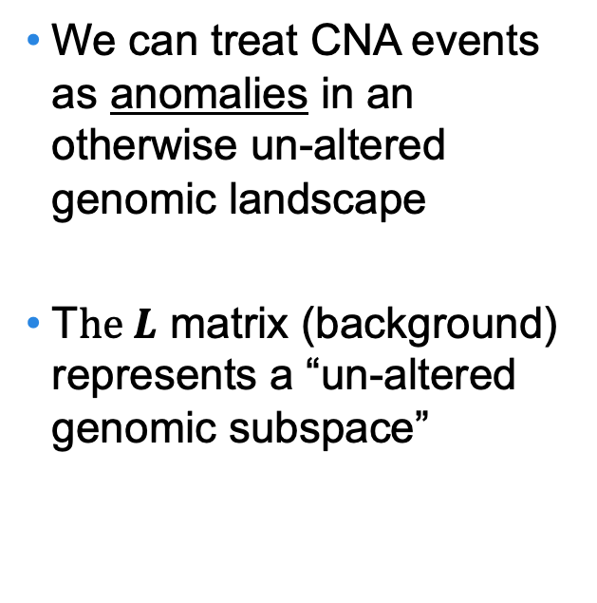
rPCA in CNA context
Methods II: Our panel of normal (PON) consists of 1,000 breast cancer samples (countmatrices)
Tumor Sample
Panel of
Normal Samples
We can treat CNA events as anomalies in an otherwise un-altered genomic landscape
T$he L$ matrix (background) represents a “un-altered genomic subspace”
Genomic Bins
Background
Foreground
Somatic CNA
Un-altered genomic subspace

Slide 9
Results I
(results from 1,000 IMPACT-468 breast cancer samples)

Slide 10
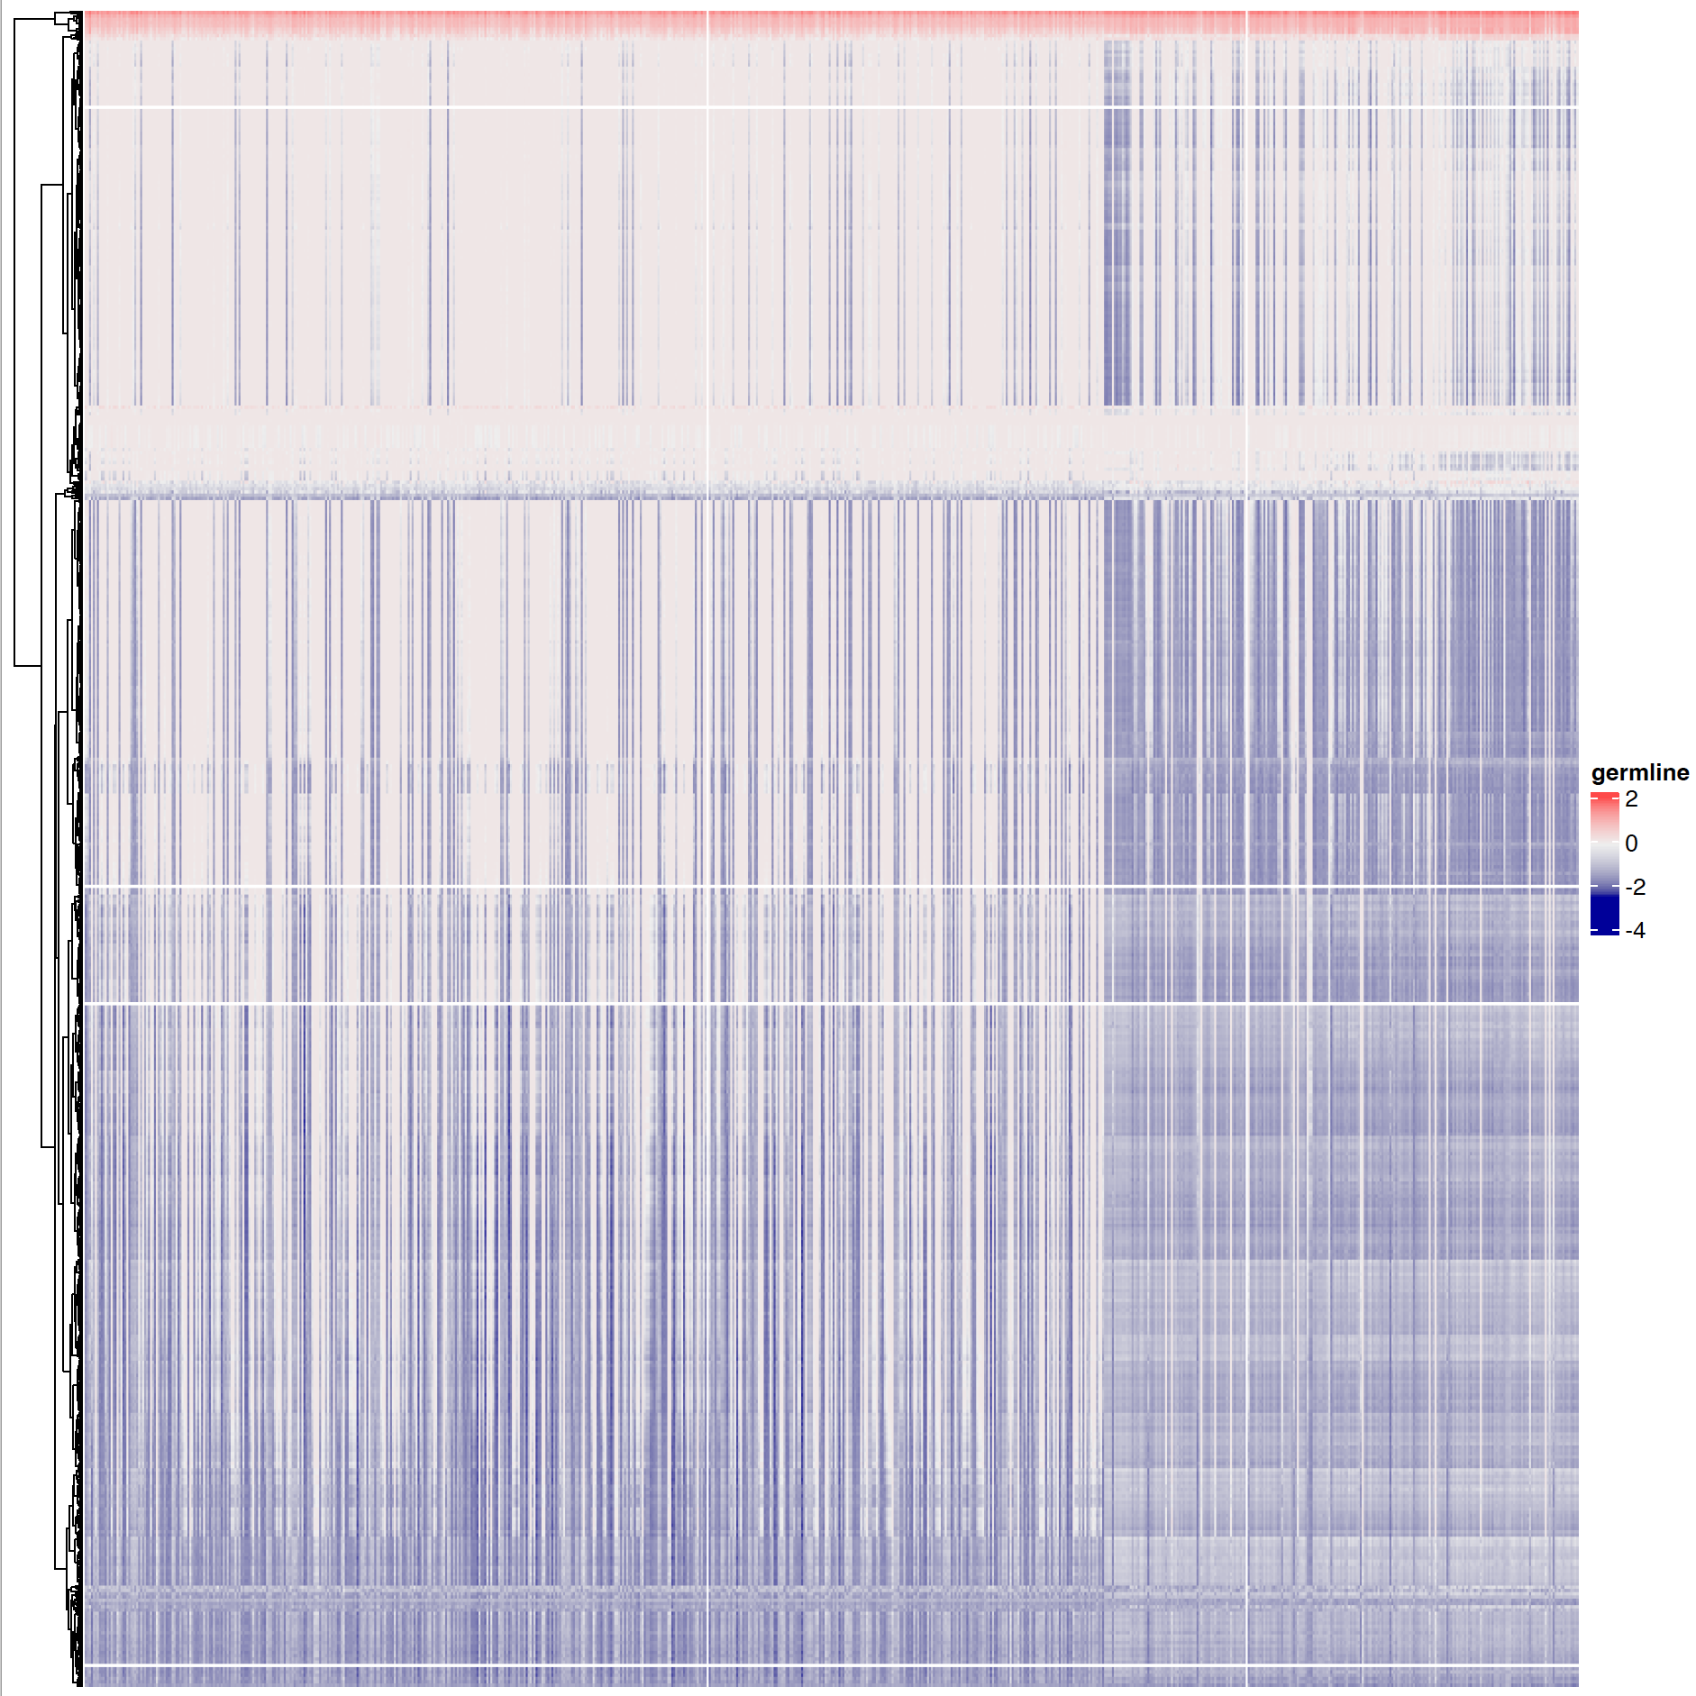
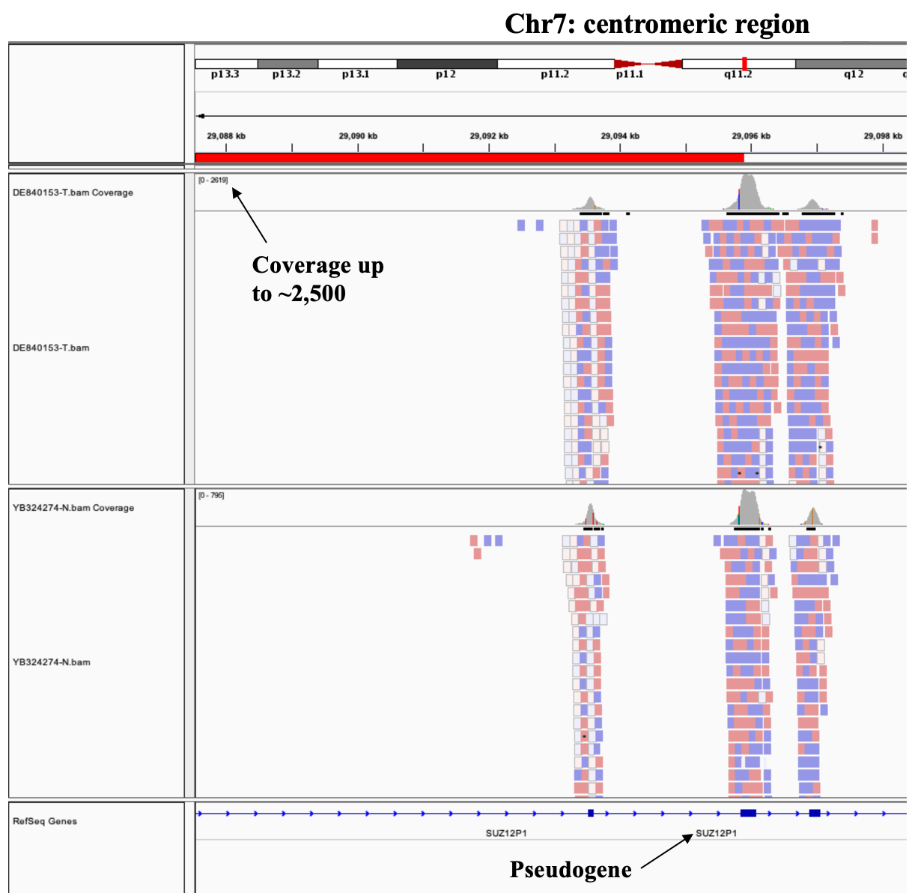
Dryclean’s background captures ’true’ noise
Results I: DryClean = R package which implements rPCA (https://github.com/mskilab/dryclean)
L-Matrix
MST1L (Pseudogene)
DKGH (non IMPACT target)
etc.
Population vs ‘private’ noise

Slide 11
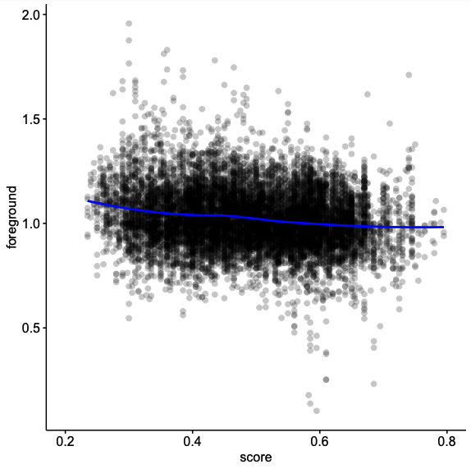
GC bias is widely flashed off
Results II: Foreground = CnLR signal corrected for GC-bias, batch-, assay effects, etc.
Foreground
GC content

Slide 12
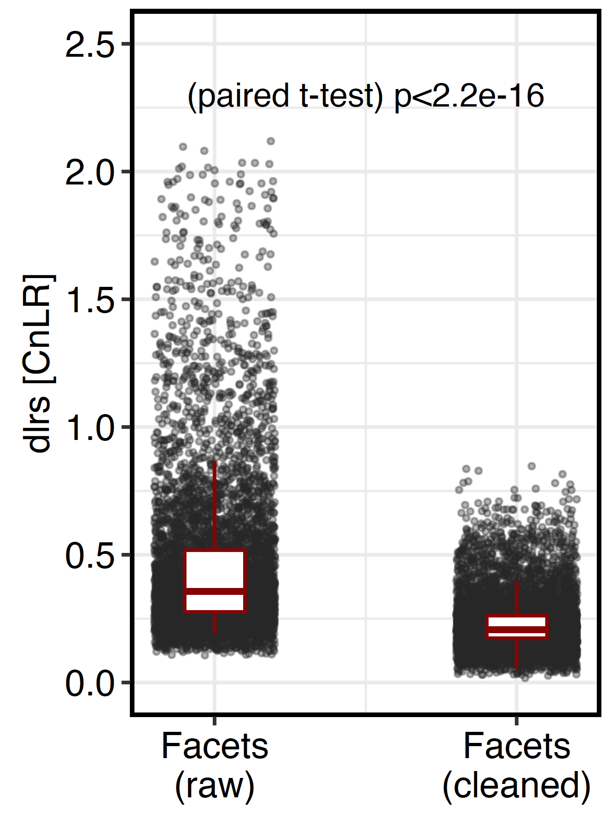
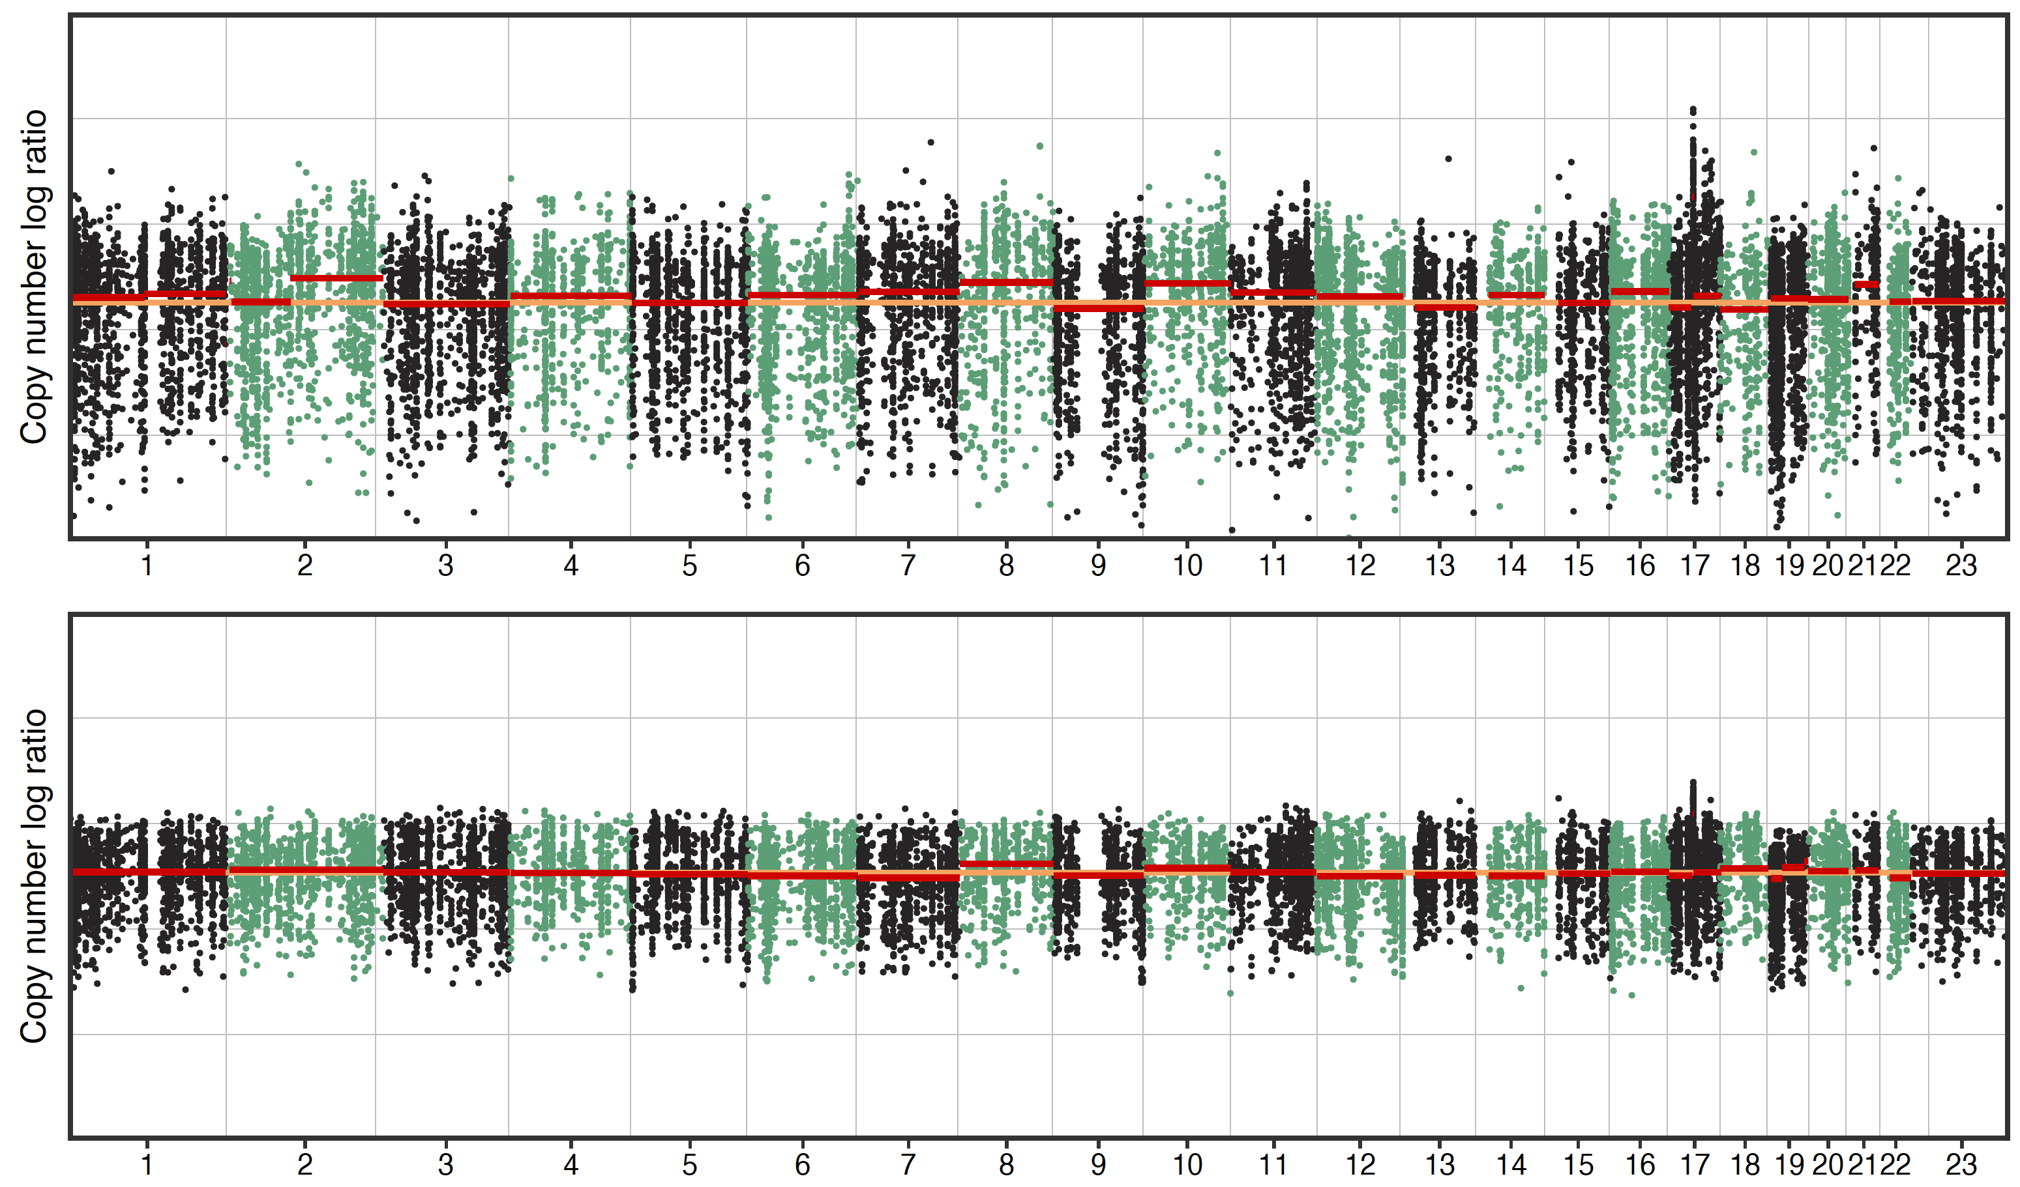
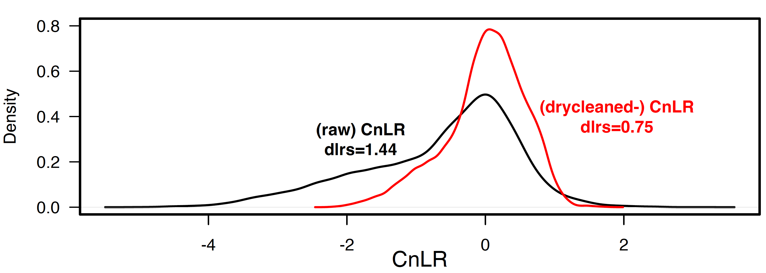
Waterfall pattern: Indication of a ‘bad’ normal*
Results III: I used dlrs as a measure of log-spread (comparaple to the standard-deviation (sd) measure)
P-0018672-T01-IM6: Original CnLR across the genome
Foreground
raw
CnLR
cleaned
CnLR
*typically attributed to assay artifact

Slide 13
IMPORTANT
Dryclean is not a copy number alteration algorithm
(just provide us with clean data)

Slide 14
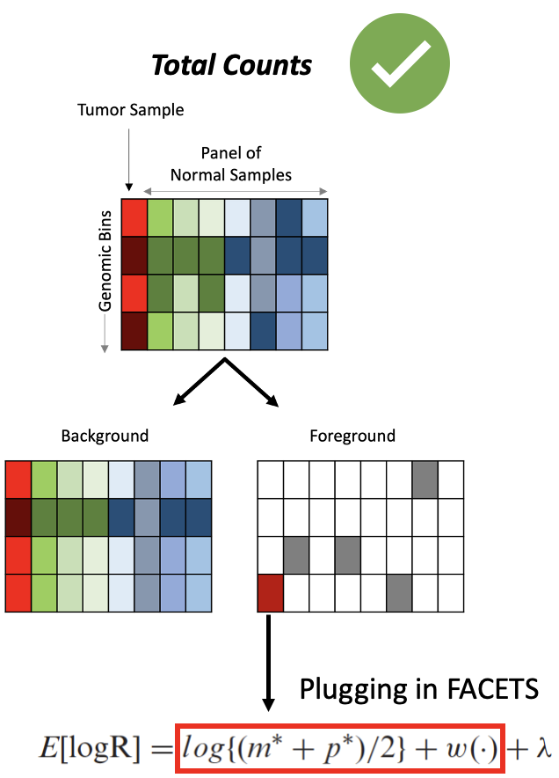
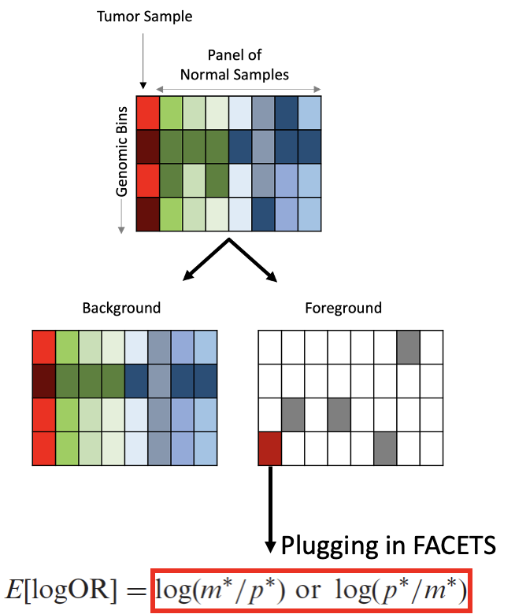
The marriage: Facets meets Dryclean
Methods III: We are comparing two things now: original Facets with the modified (cleaned) Facets algorithm
Alt Counts
allele-specific estimate [logOR];
stay with original point estimate
[...there is no indication of systematic bias, hence an allele-specific PON can be neglected]
https://github.com/chris-kreitzer/DryClean_Facets/tree/main/Scripts/DryClean_Segmentation/facets-dryclean
CnLR across the genome will systematically be replaced

Slide 15
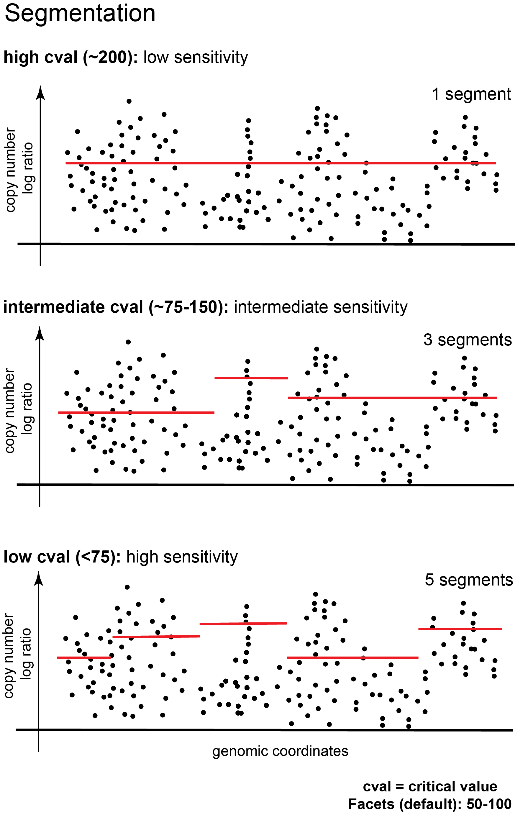
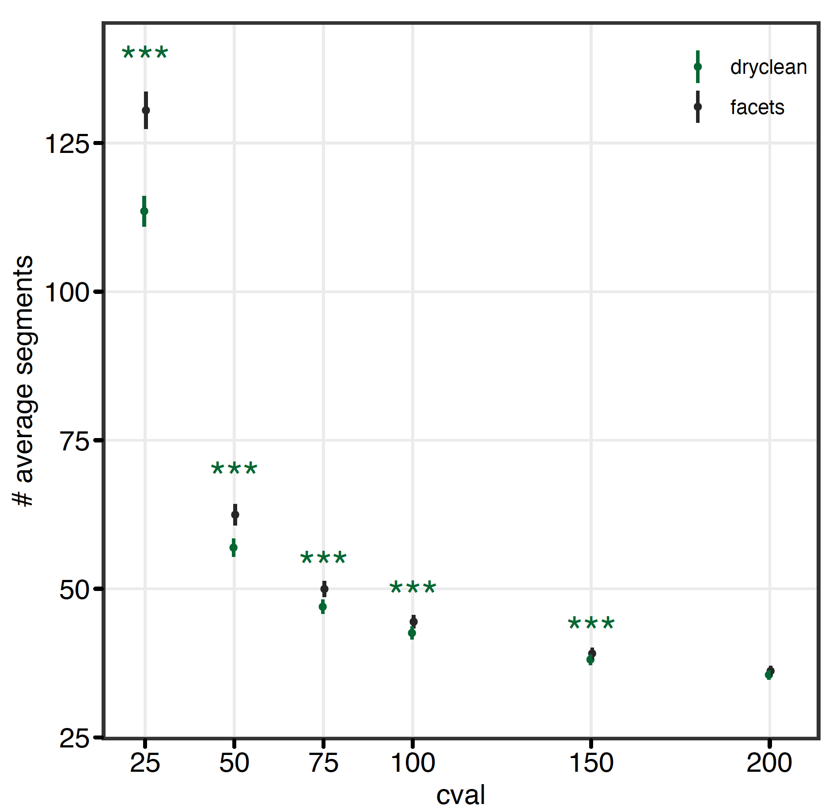
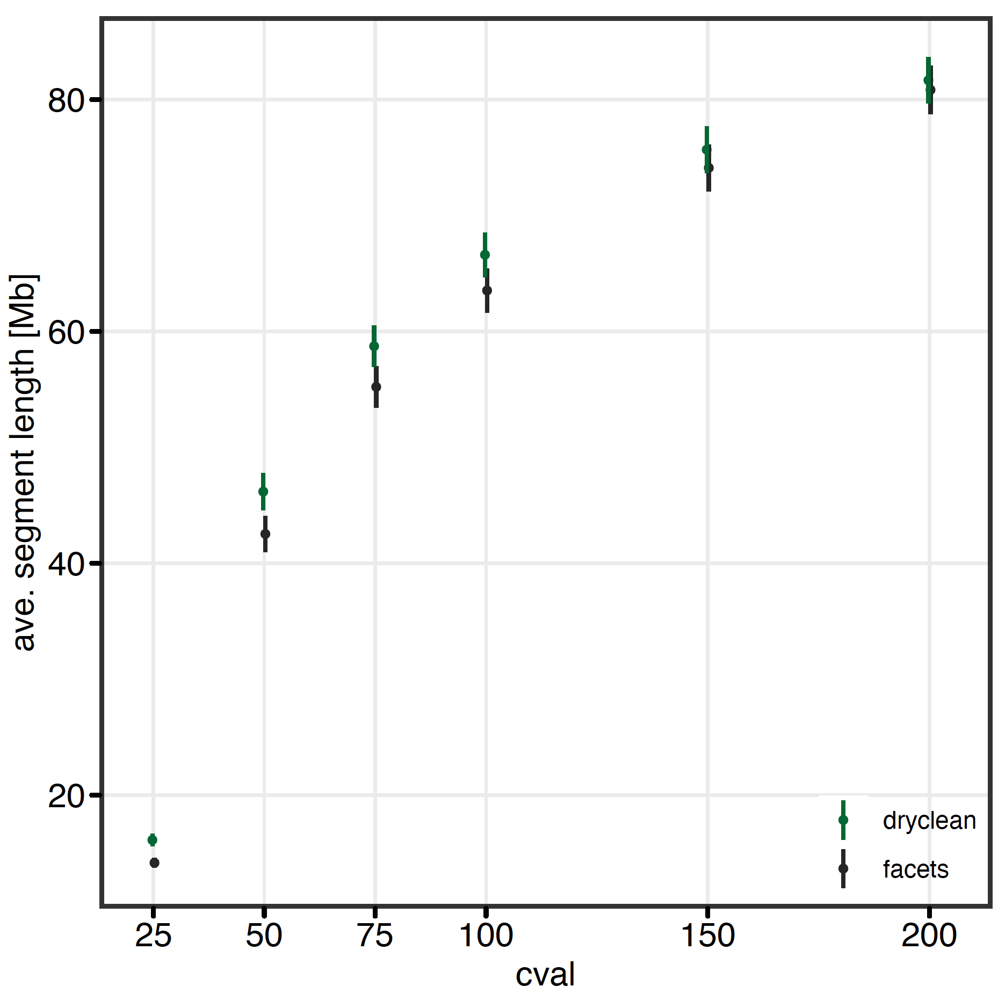
We are reducing hypersegmentation
Results IV: Most pronounced effects at low cval (useful for capturing focal events)

Slide 16
Ploidy as a summation of all aberrations
Results V: Ploidy > 5 are in general questionable
highly
questionable
safe
questionable

Slide 17
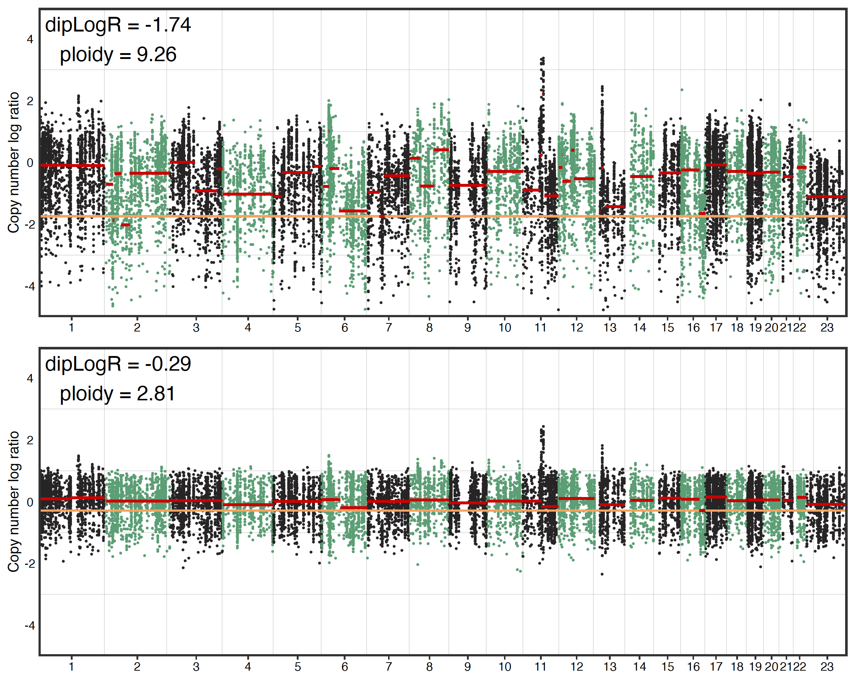
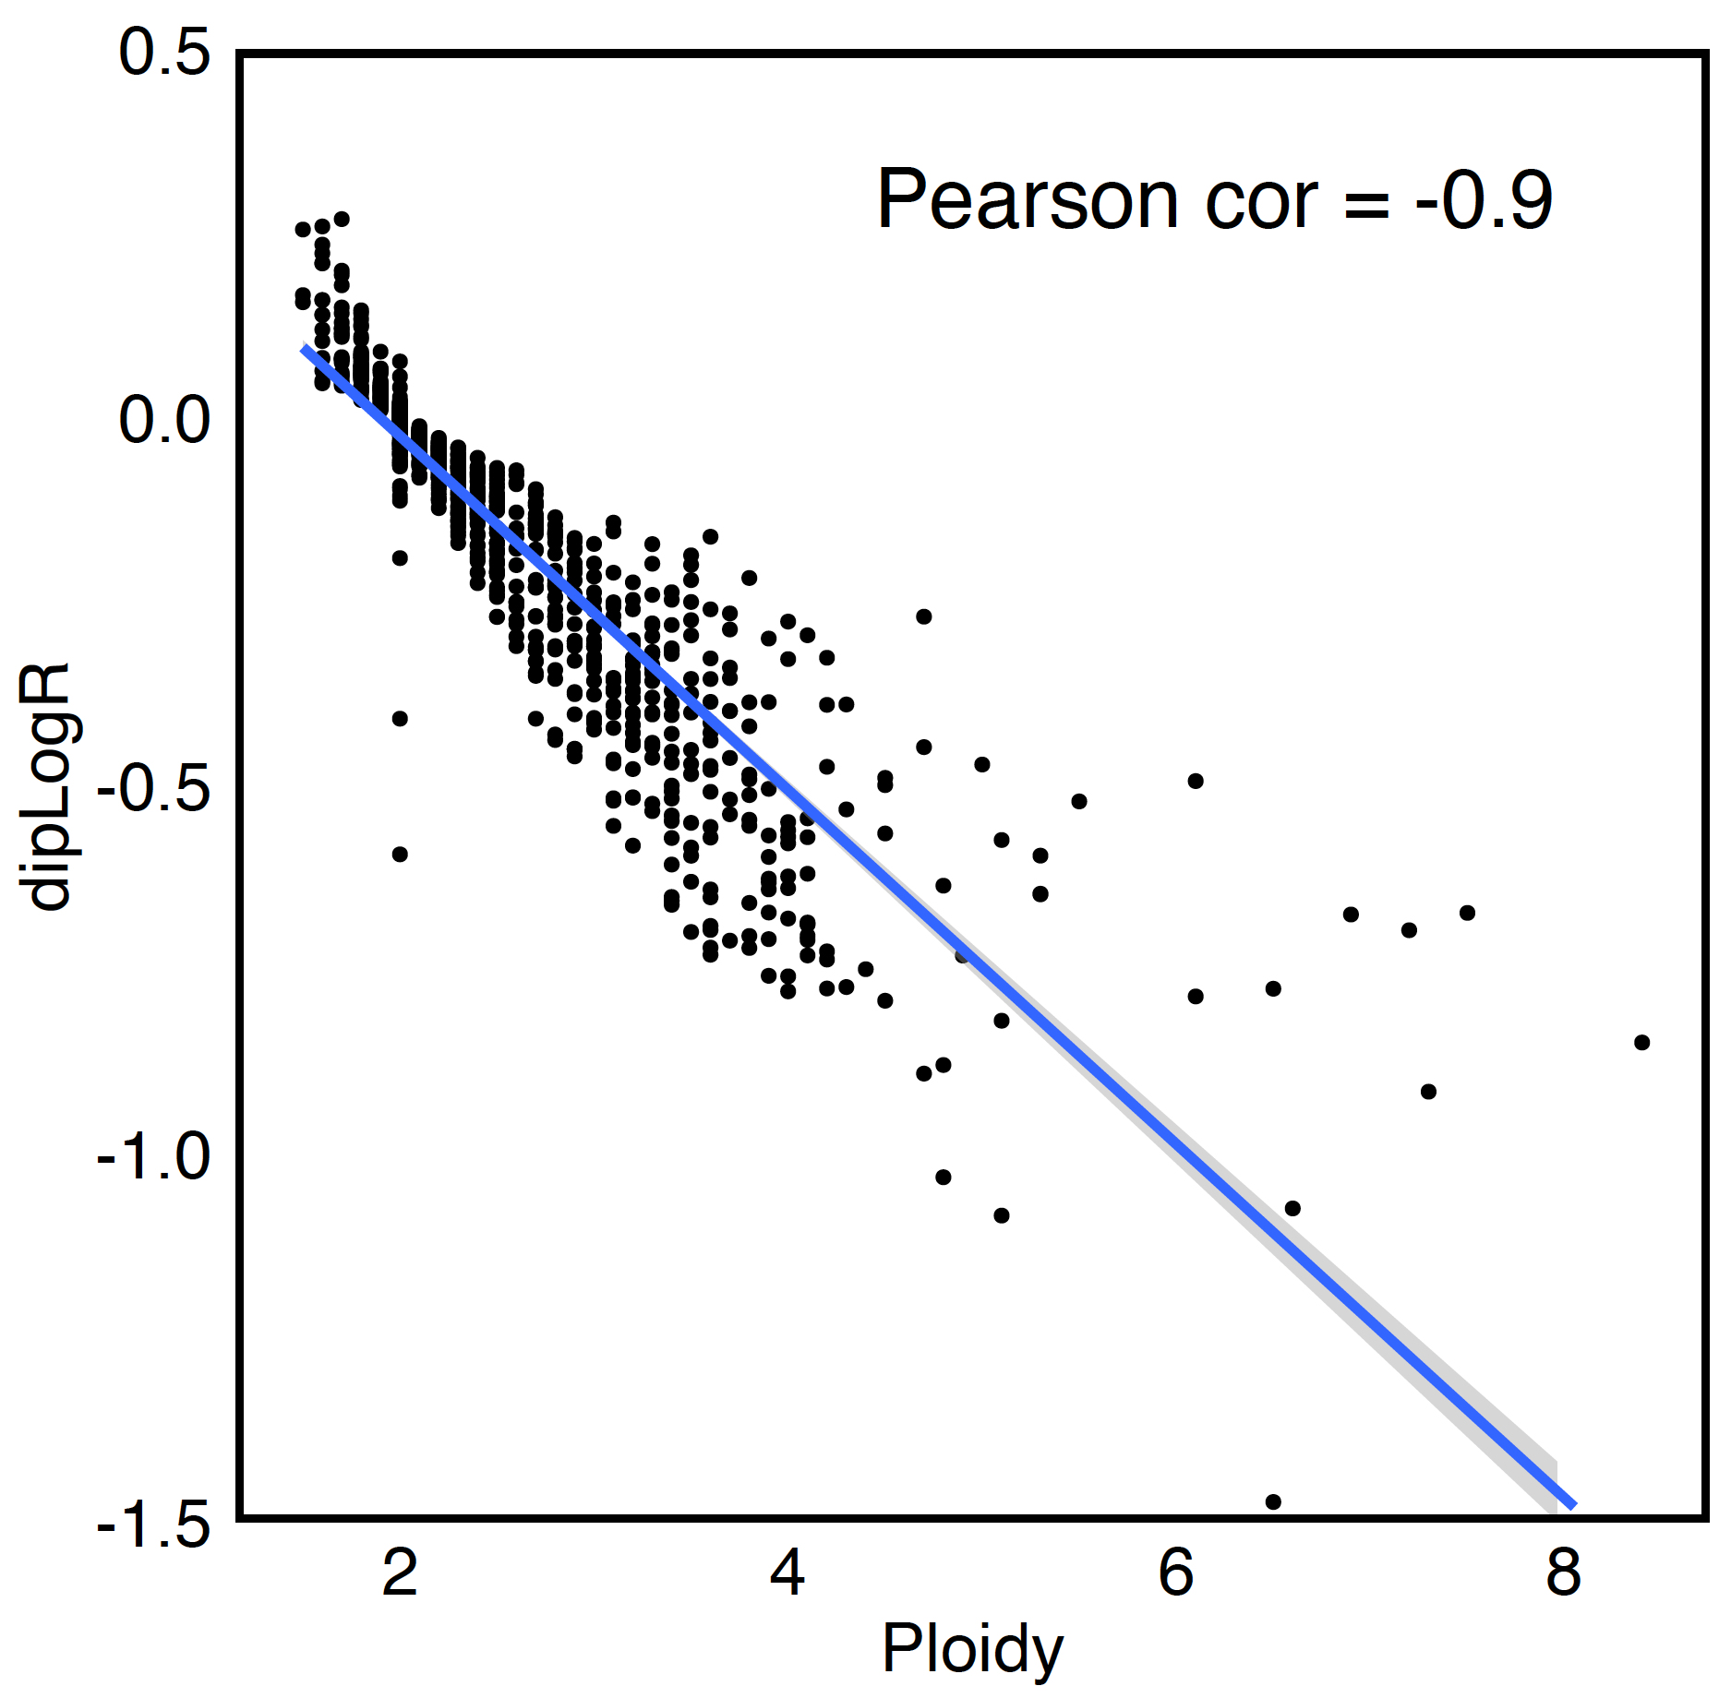
DipLogR directly influences ploidy
Results VI: Dryclean stabilizes dipLogR estimations
case example: P-0022981-T01-IM6
Foreground

Slide 18
Short summary
Dryclean makes the CNA profiling ‘normal’ agnostic
Cleaned data stabilizes segmentation and dipLogR (ploidy)
Cleaned data allows lower cvals. Hence more focal events are captures while retaining QC measures
Every copy-number fit is a guess
It’s about making the best approximation with the available data
Neither Facets nor the updated version is better!

Slide 19
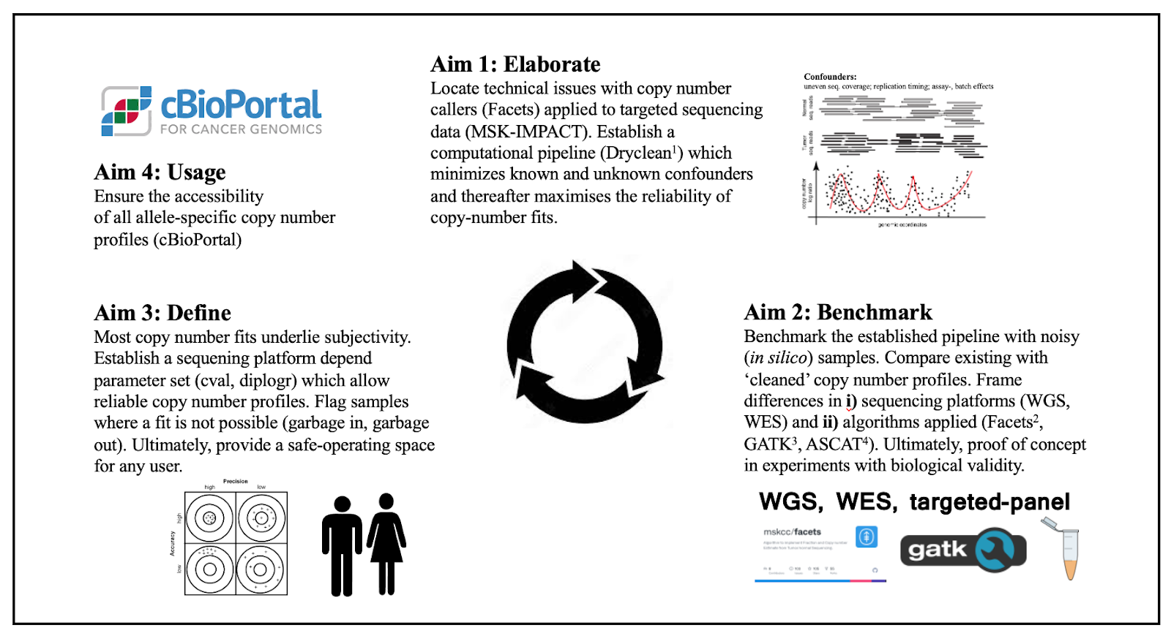
Broader context

Slide 20


Acknowledgments
Niki Schultz
AND all members
Venkatraman Seshan
Marcin Imieliński
Addy Deshpande

Slide 21
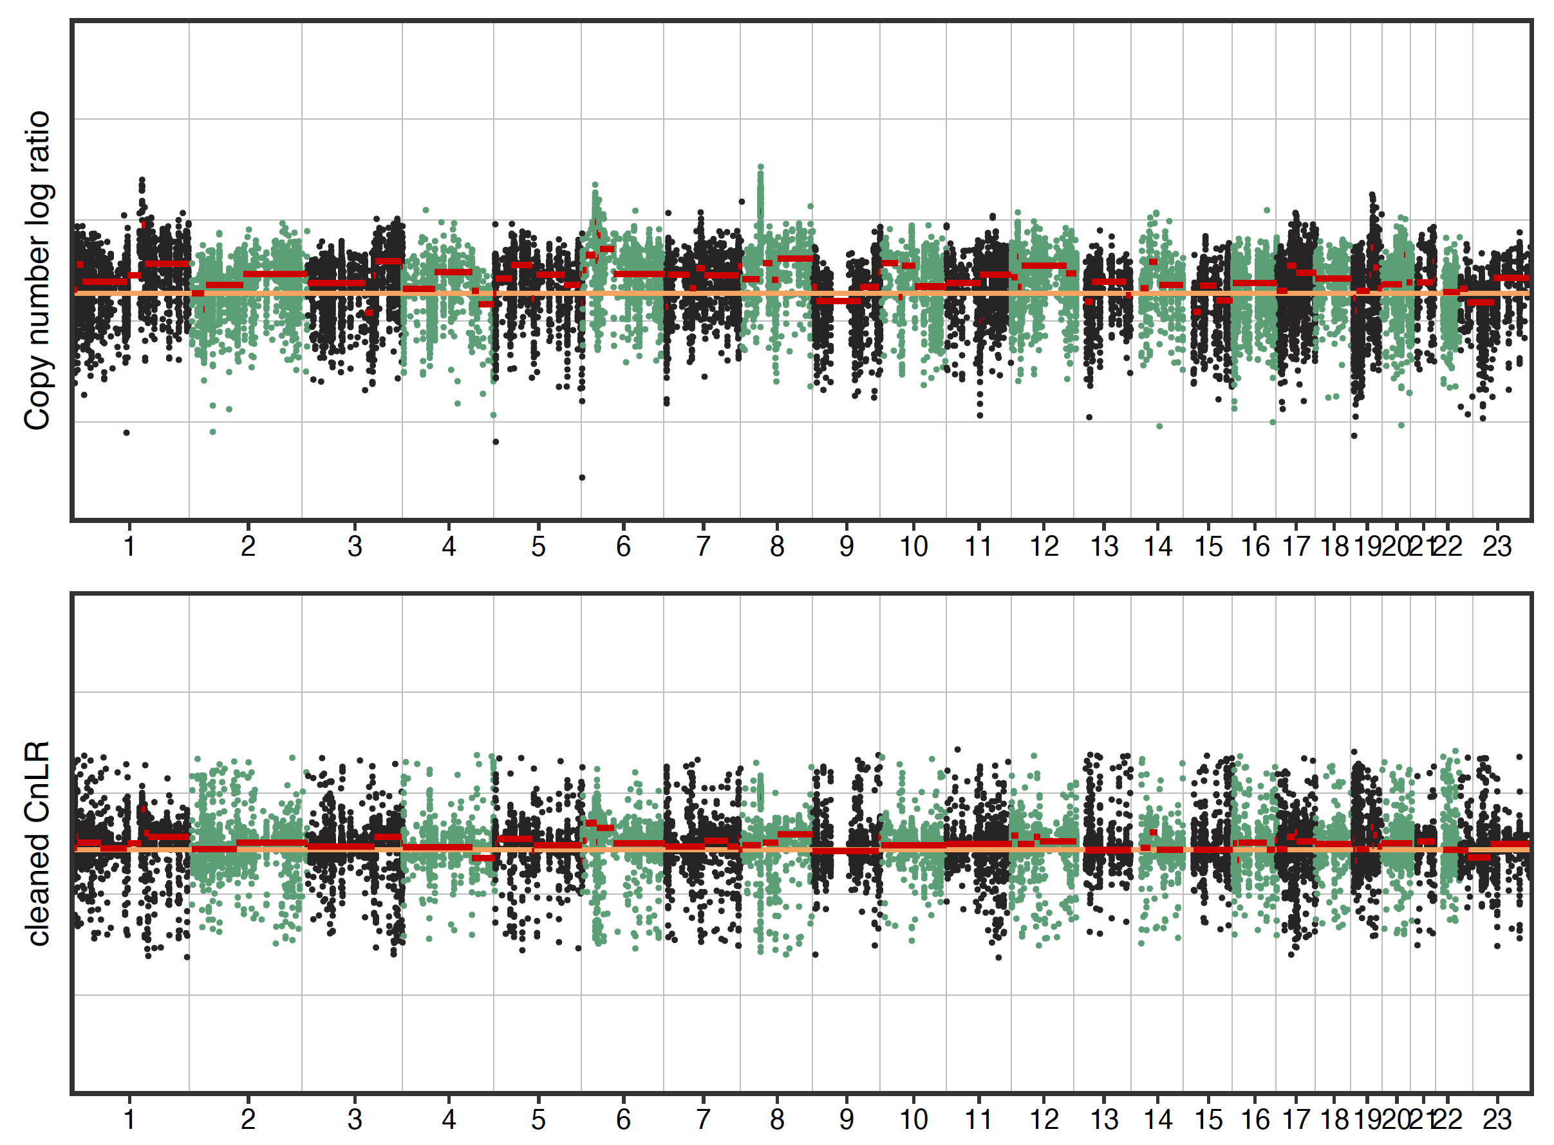
Focality (example 1): both passed QC cleaned ‘more’ focal
ERBB2
AMP; 18.9Mb
ERBB2
AMP; 4.1Mb
cBioPortal: P-0034349-T01-IM6: no 17q copy number alteration

Slide 22
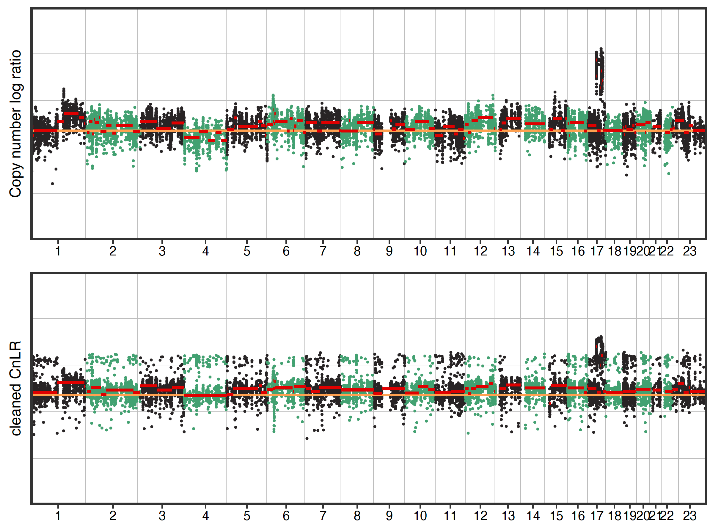
Focality (example 2): original Facets failed QC; cleaned Facets passed QC
ERBB2
AMP; 0.2Mb
ERBB2
AMP; 0.9Mb
cBioPortal: P-0027273-T01-IM6: ERBB2 AMP

Slide 23
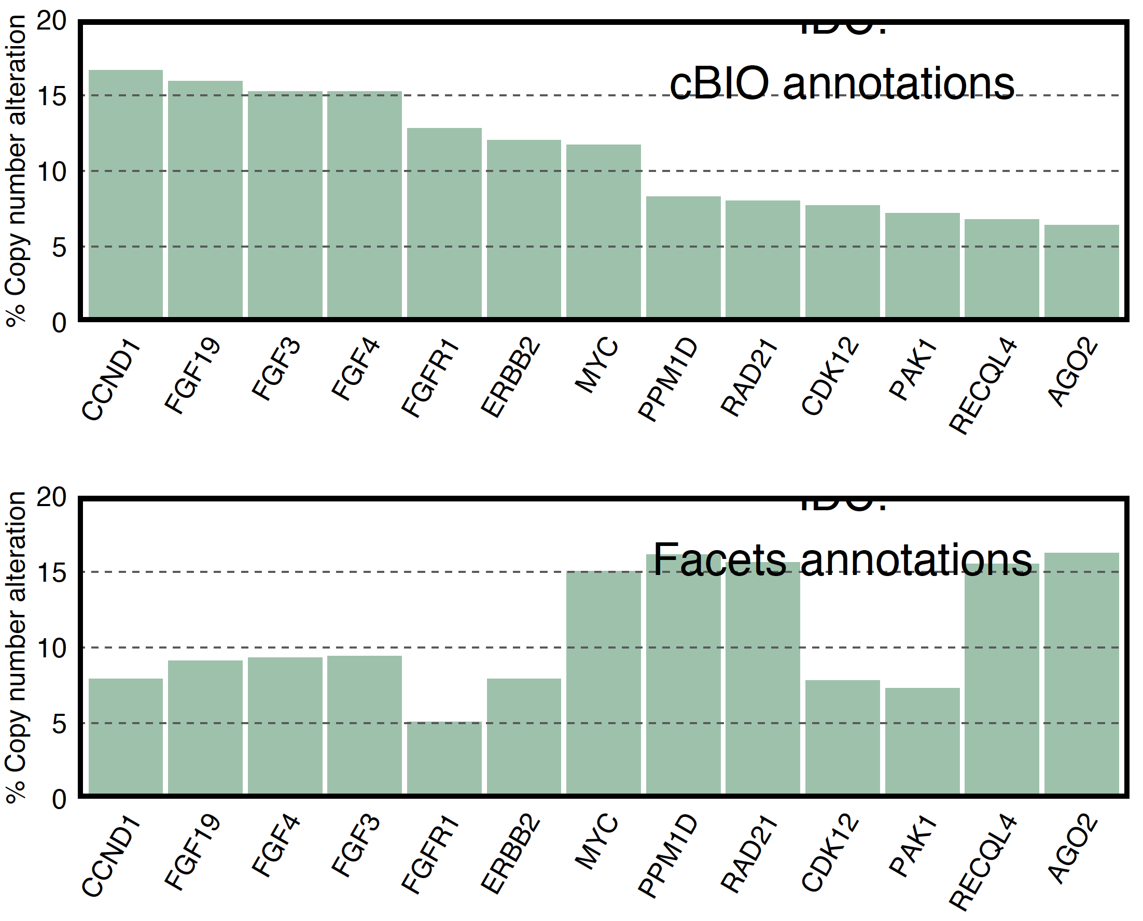
A naïve look at some genes in breast cancer
Deletion | Amplification
GATK: DepthOfCoverage tool
Homodeletions |
Gain (AMP)

Slide 24
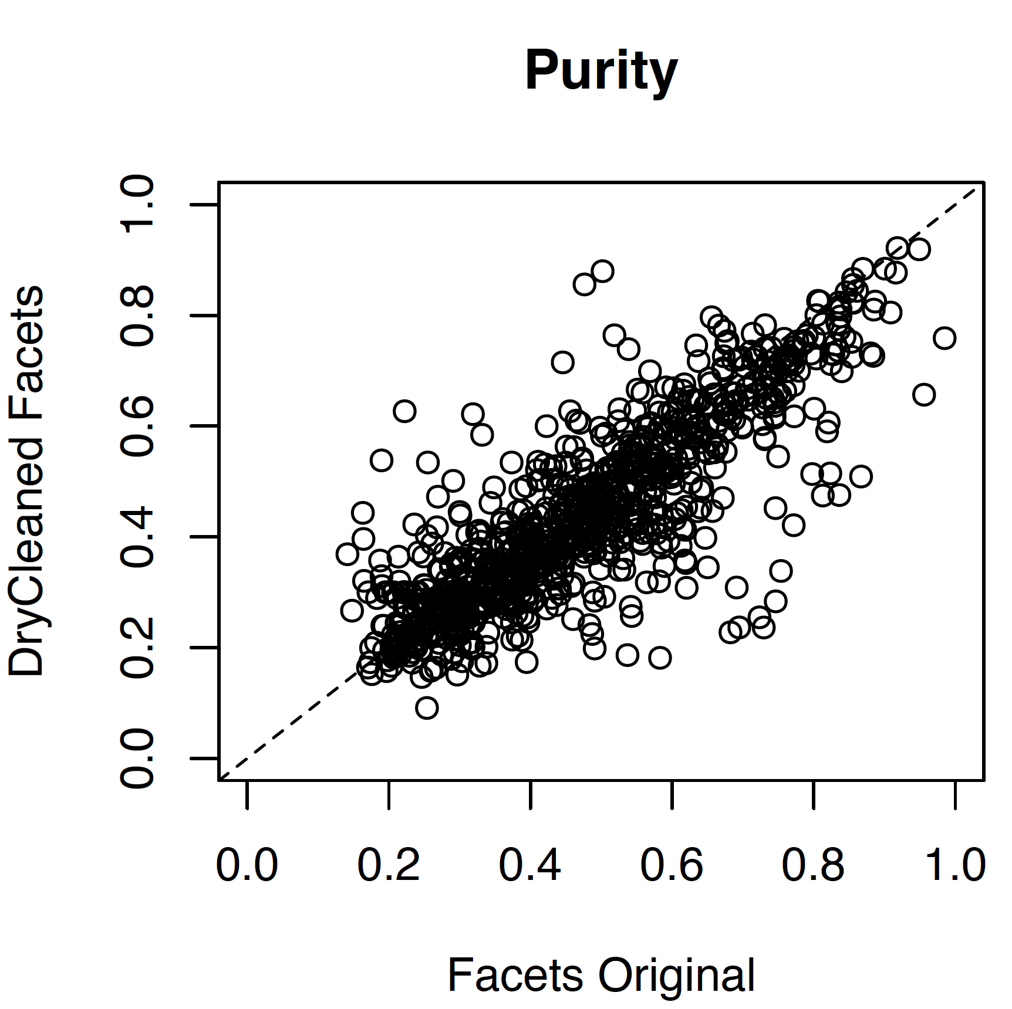

Slide 25
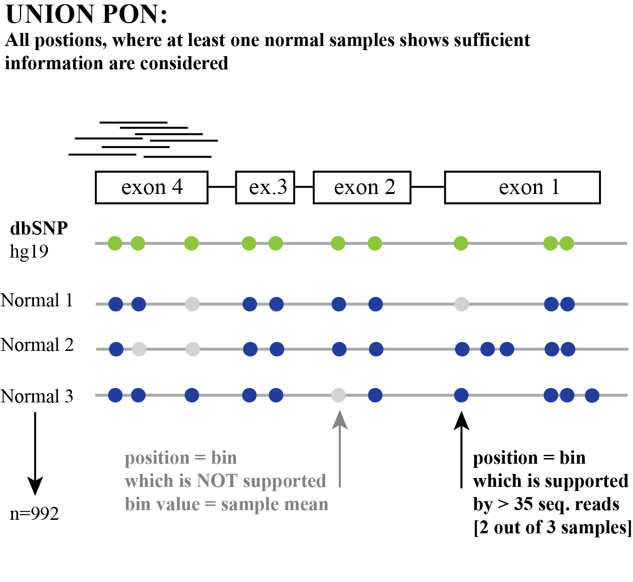

Slide 26
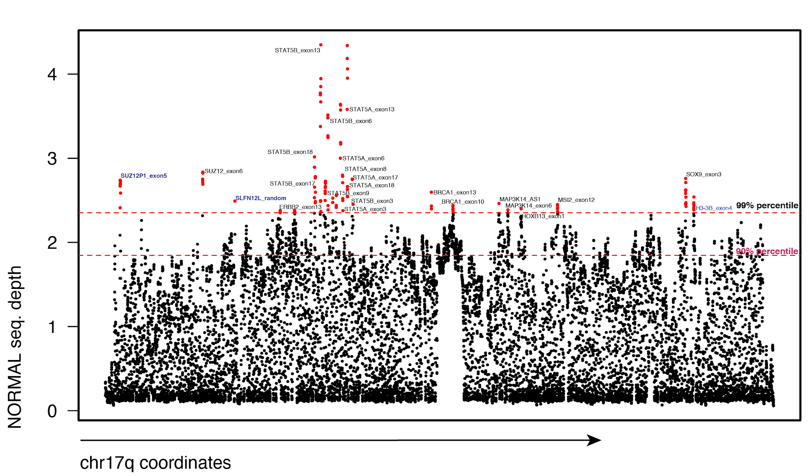
Systematic overrepresentation of certain bins in normal samples; Seq. coverage chr17q; a population average
Noise?
Noise?
Noise?
Chr17q: 26 targeted genes from IMPACT; 8 show elevated coverage

Slide 27
Novel method for read depth normalization based on robust principal component analysis: dryclean
dryclean enables sensitive detection of CNA various data formats
dryclean enables separation of replication timing wave from CNA

Slide 28
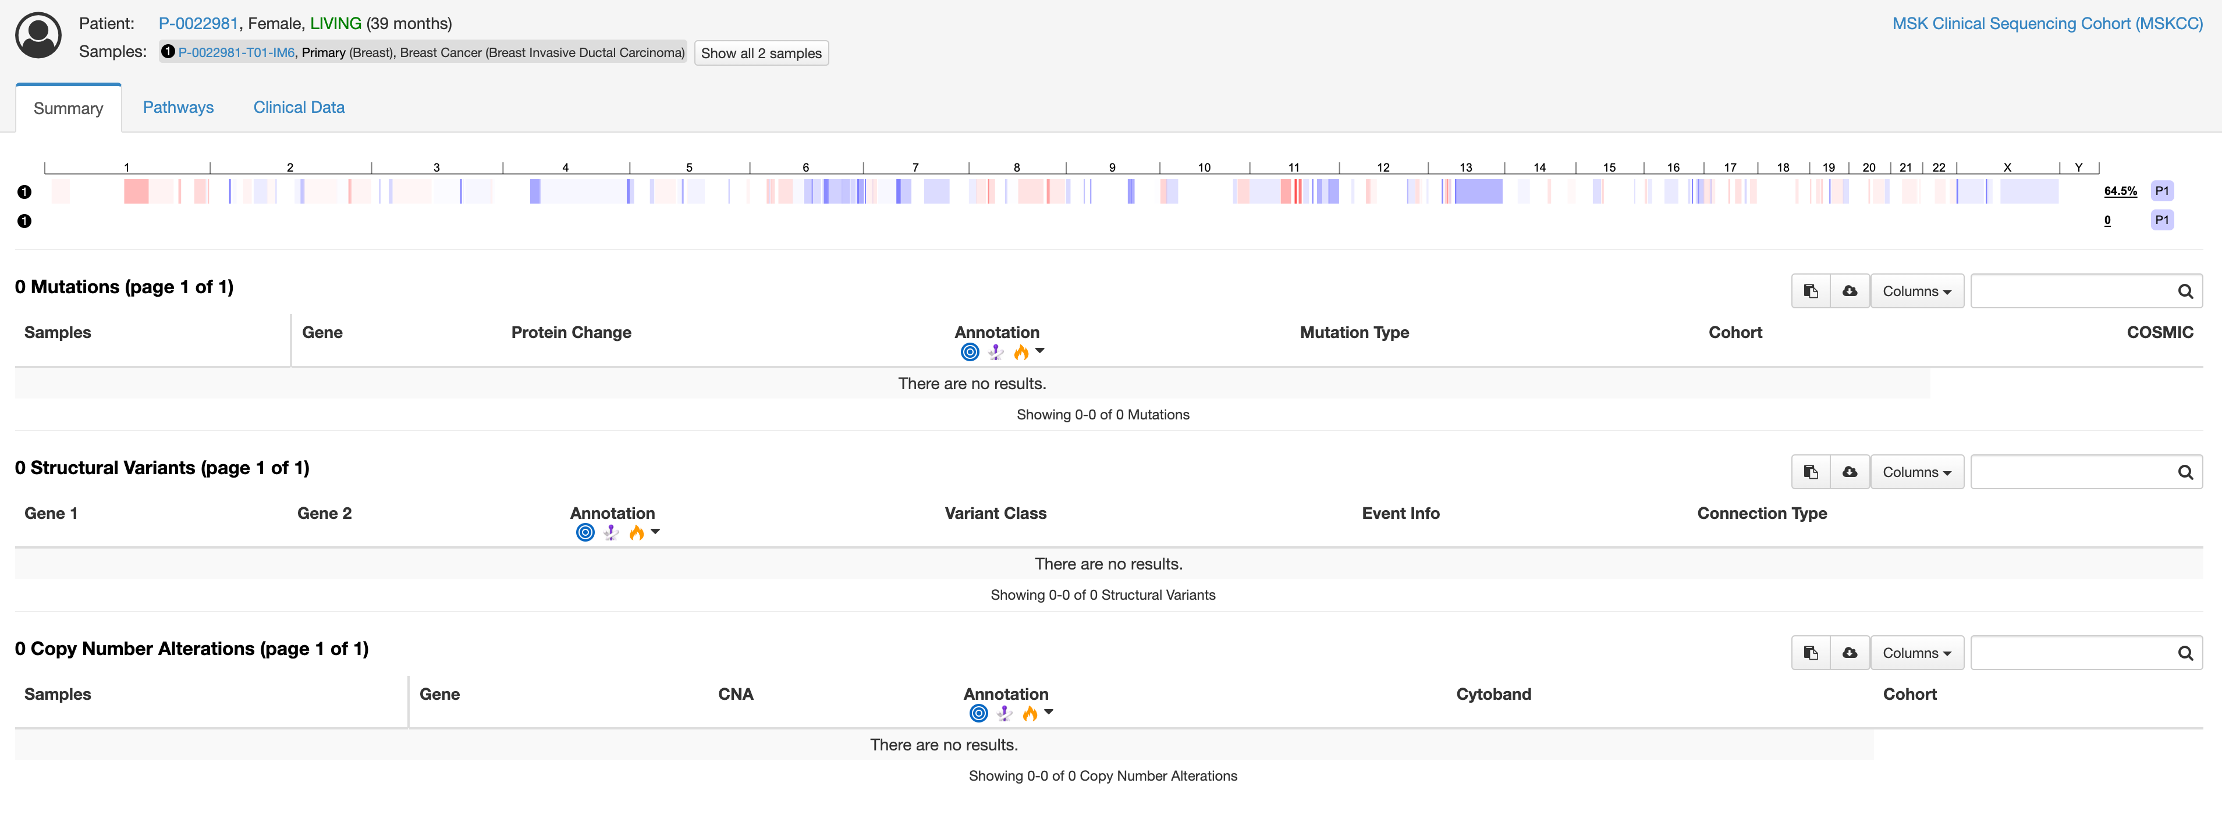
Although the genome seem highly aberrant, cbio doesn’t report any alteration: eg ERBB2

